Slide 1
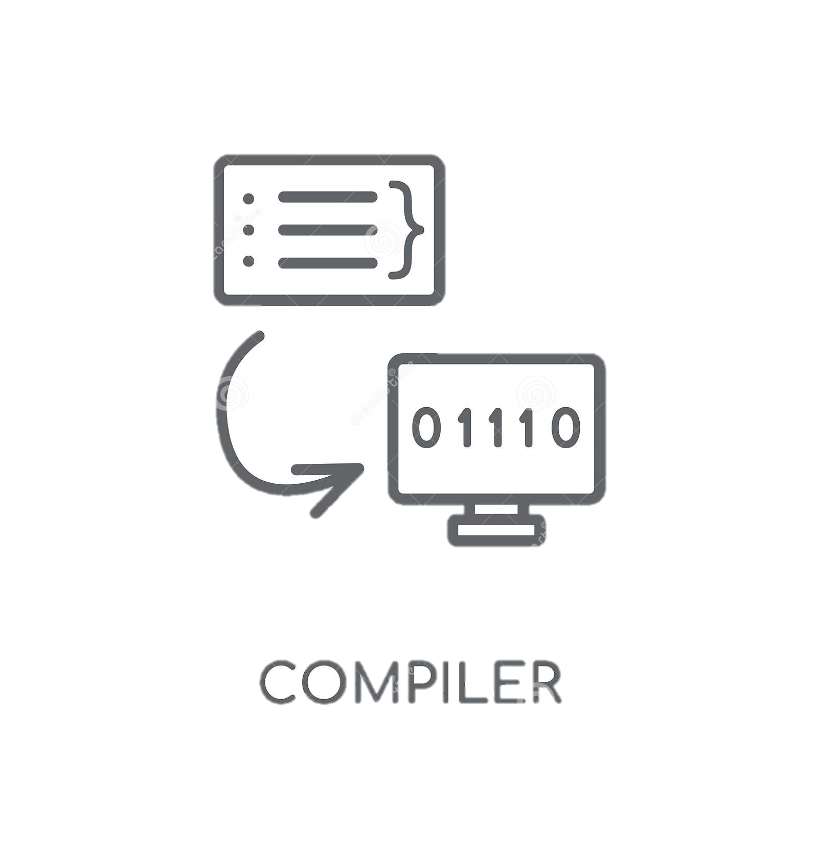
Mini C Compiler
Submitted by:
Md. Inzamam-Ul Haque Sobuz
BSSE Roll: 1113
Exam Roll: 1105
Supervised by:
Nadia Nahar
Lecturer
Institute of Information Technology

Slide 2
Source Code
Written by high level language
Machine Code
Based on Computer Architecture
Mini C
Compiler
Compiler
Source Code
Written by C language
Mini C Compiler
Syntax Errors
As Output
1

Slide 3
Ready
Why Mini C Compiler
Runnable
Fix Error
2

Slide 4
Lexical Analysis
It helps to tokenization
Syntactic Analysis
It helps to check syntax error
BackGround Study
Abstract Syntax Tree
It helps to understand grammar
Automata Theory
It helps to handle Expression
3

Slide 5
Scanning input
Lexical Analysis
Desired Errors are Shown
Project
Overview
inputted C file is split into valid tokens
takes a source file and this source file is inputted for syntax error checking
Around unique 50+ errors are categorized into 3types those are handled in this project
Syntactical Analysis
Show Errors
4

Slide 6
Missing Syntax
Types of Error
Validation Error
Multiple Instance
5

Slide 7
Effectiveness
Larger Domain
Future
Scope
More Specific Tips
Output Show
6

Slide 8
Handle Errors: 50+
Line of Code: 2500+
Summary
Language: C++
Project Link: SPL1
7

Slide 9
Project Demonstration

Slide 10
Thank You

